Slide 1


CS1010: Programming Methodology
UNIT 17
Call by Reference
Live Q&A
https://pollev.com/jin

Slide 2
Unit 17: Call by Reference
Pure Functions (Call by Value)
Functions with Side Effects (Call by Reference)

Slide 3
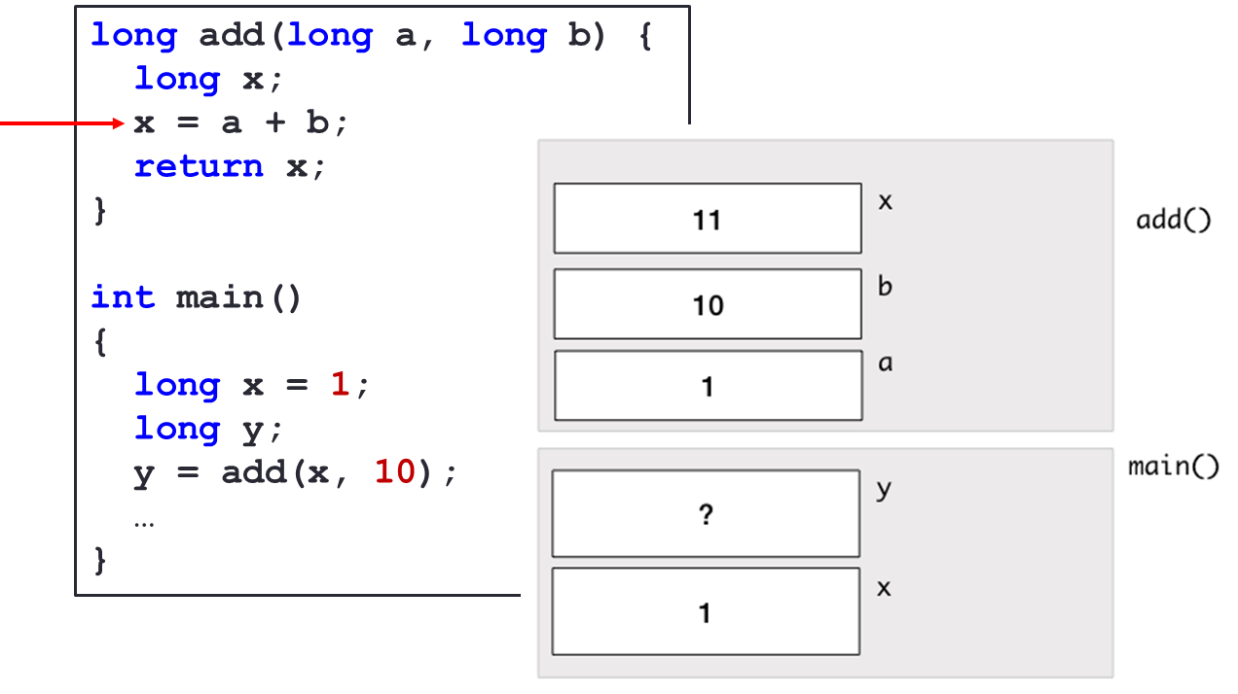
Pure Functions
Do not affect the variables in other functions due to the Call-by-Value mechanism
The value of a variable is passed into function.

Slide 4
Pure Functions
Benefits: Easy to debug
Every function is self-contained
Limitations: Unable to return multiple values
Only a single value can be returned (via the return statement).
Does the following function f(n) return both 2n and 3n?
long f(long n) {
return 2 * n;
return 3 * n;
}
No. Once a return statement is executed, the function ends immediately.

Slide 5

Example: Swap()
Problem: Swap two values.
…
long main() {
long var1, var2;
long var1 = cs1010_read_long();
long var2 = cs1010_read_long();
swap(var1, var2);
cs1010_print_long(var1);
cs1010_print_string(" ");
cs1010_print_long(var2)
return 0;
}
void swap(long var1, long var2) {
long temp;
temp = var1; var1 = var2; var2 = temp;
}
Input: 72 9
Output: 72 9

Slide 6
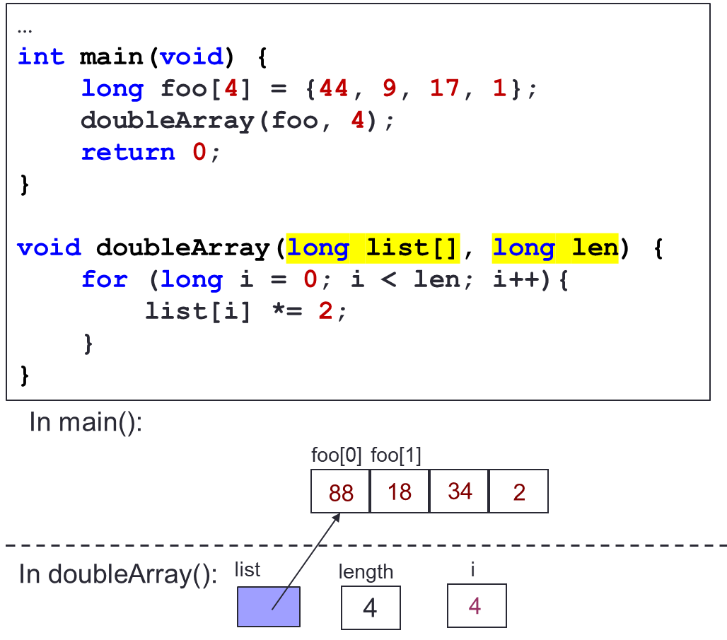
Functions with Side Effects
Affects the variables in other functions due to the Call-by-Reference mechanism
The reference / address of a variable is passed into function
foo is affected by doubleArray since the address of the array is passed in.

Slide 7
Example: Swap()
9
72
In main():
var1
72
var2
9
…
int main() {
long var1 = cs1010_read_long();
long var2 = cs1010_read_long();
swap(&var1, &var2);
cs1010_print_long(var1);
cs1010_print_string(" ");
cs1010_print_long(var2)
}
void swap(long *ptr1, long *ptr2) {
long temp;
temp = *ptr1; *ptr1 = *ptr2; *ptr2 = temp;
}
In swap():
ptr1
ptr2
Input: 72 9
Output: 9 72

Slide 8
Example: Collatz from Assignment 2
Problem: … Print the number with the largest total stopping time and its corresponding total stopping time …
…
int main() {
long n = cs1010_read_long();
long max_num_steps;
long max_n;
find_max_steps(n, &max_n, &max_num_steps);
cs1010_println_long(max_n);
cs1010_println_long(max_num_steps);
}

Slide 9
Example: Collatz from Assignment 2
void find_max_steps(long n, long *max_n, long *max_num_steps) {
*max_num_steps = 0;
*max_n = 1;
for (long i = 1; i <= n; i += 1) {
long num_of_steps = count_num_of_steps(i);
if (num_of_steps >= *max_num_steps) {
*max_n = i;
*max_num_steps = num_of_steps;
}
}
}

